Slide 1
cloud computing Unit-III

Slide 2
Virtualization
Virtualization is a fundamental mechanism for delivering cloud services.
Virtualization refers to the creation of a virtual resource such as a server, desktop, operating system, file, storage or network.
The main goal of virtualization is to manage workloads by radically transforming traditional computing to make it more scalable.

Slide 3
Continue..
The most common form of virtualization is the operating system-level virtualization. In operating system-level virtualization, it is possible to run multiple operating systems on a single piece of hardware.
Virtualization technology involves separating the physical hardware and software by emulating hardware using software. When a different OS is operating on top of the primary OS by means of virtualization, it is referred to as a virtual machine.
A virtual machine is nothing but a data file on a physical computer that can be moved and copied to another computer, just like a normal data file.

Slide 4
Question
Which of the following network resources can be load balanced?
a) Connections through intelligent switches
b) DNS
c) Storage resources
d) All of the mentioned

Slide 5
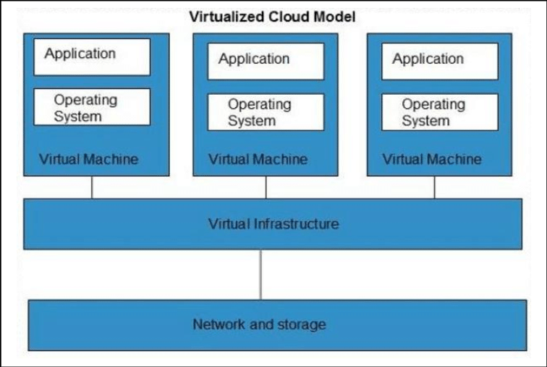
Virtualization

Slide 6
Characteristics of Virtual Machines
Virtualization has three characteristics that make it ideal for cloud computing:
Partitioning: In virtualization, many applications and operating systems (OS) are supported in a single physical system by partitioning (separating) the available resources
Isolation: Each virtual machine is isolated from its host physical system and other virtualized machines. Because of this isolation, if one virtual instance crashes, it does not affect the other virtual machines. In addition, data are not shared between one virtual container and another.

Slide 7
Continue..
Encapsulation: A virtual machine can be represented (and even stored) as a single file, so that you can easily identify it based on the service it provides. In essence, the encapsulated process could be a business service. This encapsulated virtual machine can be presented to an application as a complete entity. Therefore, encapsulation can protect each application so that it does not interfere with another application

Slide 8
Using a Hypervisor in Virtualization
A hypervisor is an operating system, which makes things happen in an orderly manner. The hypervisor sits at the lowest levels of the hardware environment.
Because in cloud computing you need to support many different operating environments, the hypervisor becomes an ideal delivery mechanism.
The hypervisor lets you show the same application on lots of systems without having to physically copy that application onto each system.

Slide 9
Continue..
It is designed like a mainframe OS rather than the Windows operating system.
The hypervisor, therefore, schedules the amount of access everything that guest OSes have to from the CPU, to memory, to disk I/O and to any other I/O mechanisms.
With virtualization technology, you can set up the hypervisor to split the physical computer’s resources.

Slide 10
Question
Which of the following type of virtualization is also characteristic of cloud computing?
a) Storage
b) Application
c) CPU
d) All of the mentioned

Slide 11
Types of Hypervisor
Type 1 Hypervisor (also called bare metal or native)
Type 2 Hypervisor (also known as hosted hypervisors)
Embedded Hypervisor

Slide 12
Types-1 Hypervisor
A bare-metal hypervisor (Type 1) is a layer of software we install directly on top of a physical server and its underlying hardware.
There is no software or any operating system in between, hence the name bare-metal hypervisor. A Type 1 hypervisor is proven in providing excellent performance and stability since it does not run inside Windows or any other operating system.
Type 1 hypervisors are an OS themselves, a very basic one on top of which you can run virtual machines. The physical machine the hypervisor is running on serves virtualization purposes only. You cannot use it for anything else.
Type 1 hypervisors are mainly found in enterprise environments.

Slide 13
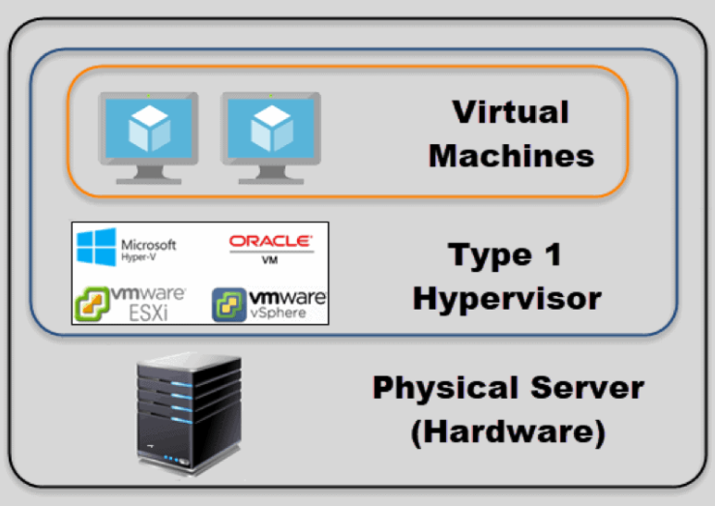
Types-1 Hypervisor

Slide 14
Types-2 Hypervisor
This type of hypervisor runs inside of an operating system of a physical host machine.
This is why we call type 2 hypervisors – hosted hypervisors. As opposed to type 1 hypervisors that run directly on the hardware, hosted hypervisors have one software layer underneath. In this case we have:
A physical machine.
An operating system installed on the hardware (Windows, Linux, macOS).
A type 2 hypervisor software within that operating system.
The actual instances of guest virtual machines.

Slide 15
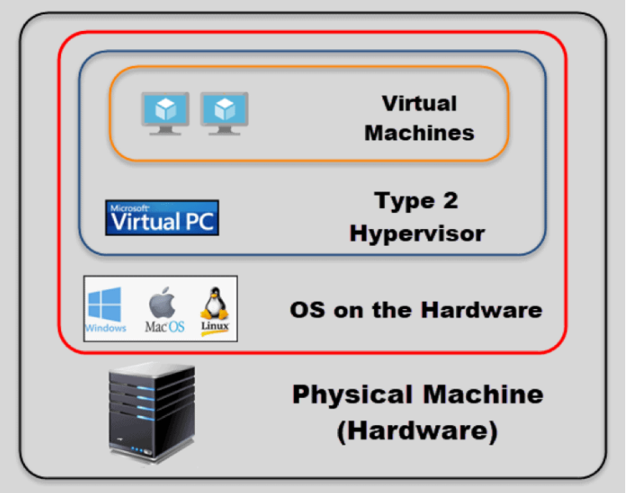
Types-2 Hypervisor

Slide 16
Embedded Hypervisor
An embedded hypervisor is a hypervisor that supports the requirements of embedded systems.
An embedded hypervisor is designed into the embedded device from the outset, rather than loaded subsequent to device deployment.
Mobile virtualization overlaps with embedded system virtualization, and shares some use cases.
Typical attributes of embedded virtualization include efficiency, security, communication, isolation and real-time capabilities.

Slide 17
Virtualization Benefits
New systems can be setup easily.
No need to invest in hardware for testing and debugging setups.
The capability to recover quickly from system corruption.
Relocating and migrating systems with ease. For example, moving to a more powerful machine can simply be a matter of taking a snapshot of a virtual machine and starting up a new virtual machine based on that snapshot.
The ease of remote management. Physical access to data centers is tightly controlled these days. The use of virtual machines greatly reduces the need for physical access.
Multiple operating systems can be run simultaneously on one server.

